Slide 1
Simulation of cell growth
Types of cell – 1 (cancer)

Slide 2
Part 1 : Distribution of free Space, Number of Cells, Surface heterogeneity, and volume heterogeneity against time(mcs)

Slide 3
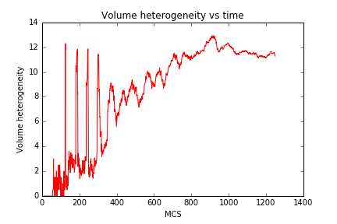
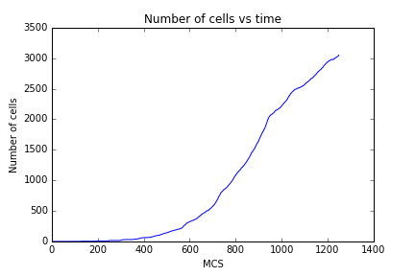
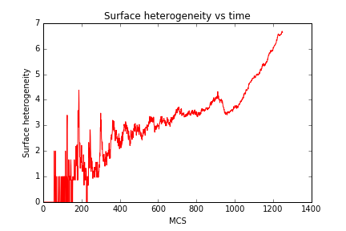
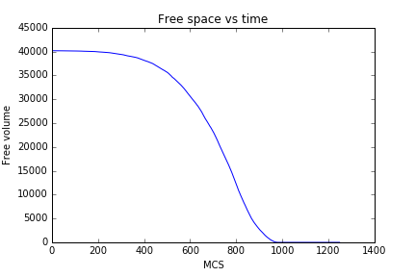
Square Plate ( Area – 40000 )

Slide 4
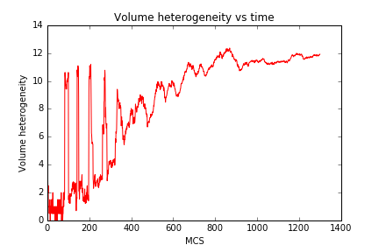
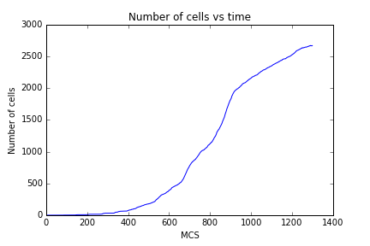
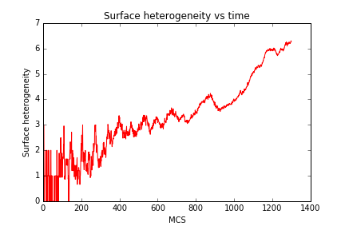
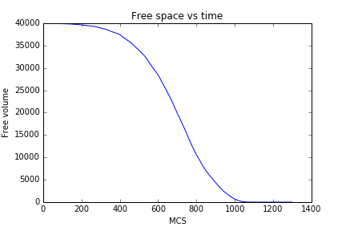
Triangular plate ( Area – 40000)

Slide 5
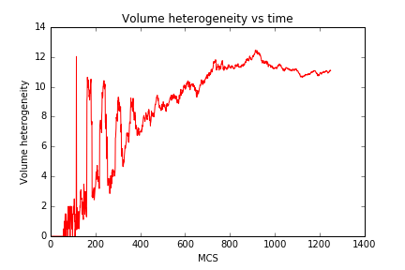
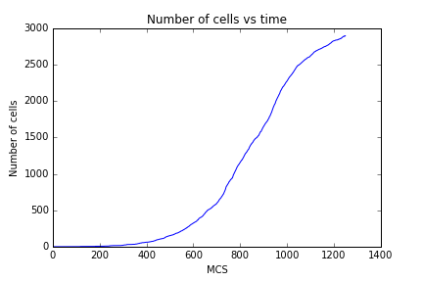
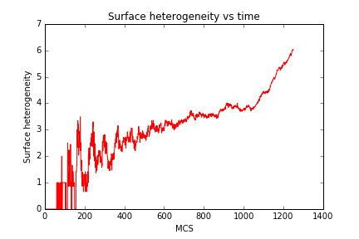

Circle ( Radius r, area – 40000)

Slide 6
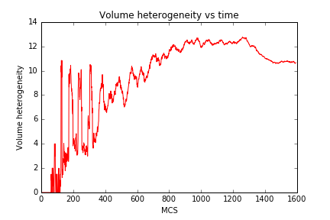
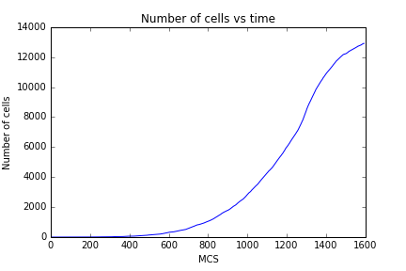
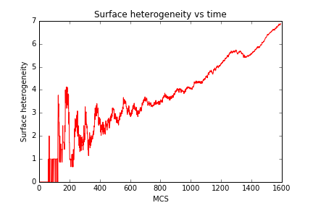
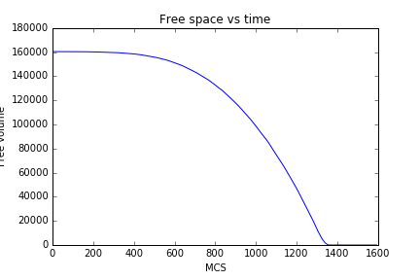
Circle ( radius – 2r , area – 160000)

Slide 7
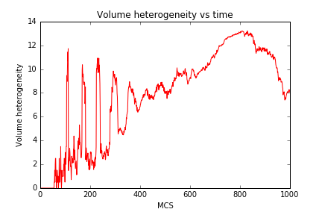
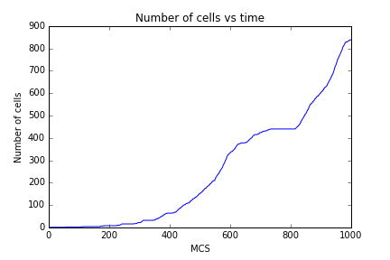
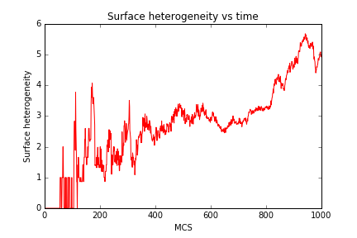
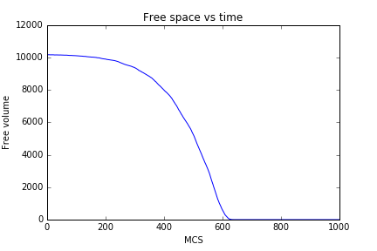
Circle ( Radius – R/2, Area – 10000)

Slide 8
Part 2 : Volume distribution at t_end , T_end + 100 and T_end + 200 where T_end denotes the mcs where the plate area is completely filled

Slide 9
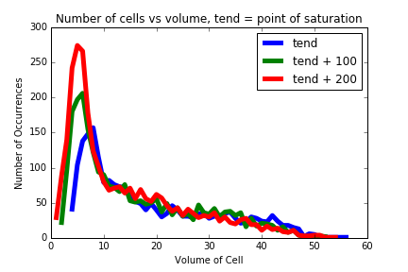
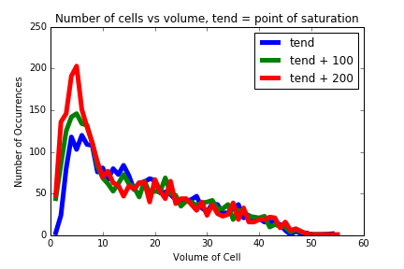
Graphs for square and triangle (both plates of same area 40000)
Square
Triangle

Slide 10
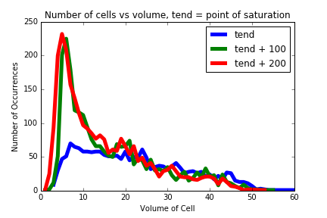
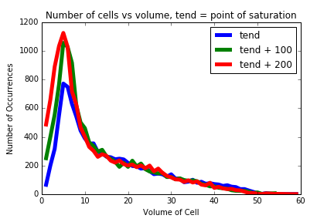
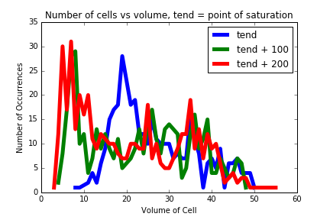
Graphs for plates of radius r, 2r and r/2
Circle ( Radius R/2,Area – 10000)
Circle ( Radius R, Area – 40000)
Circle ( Radius 2R, Area – 160000)

Slide 11
Part 3 : AREA distribution at t_end , T_end + 100 and T_end + 200 where T_end denotes the mcs where the plate area is completely filled

Slide 12
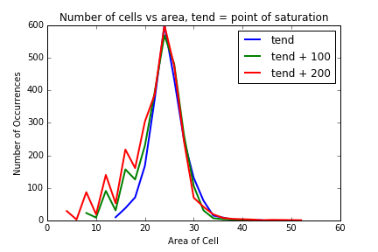
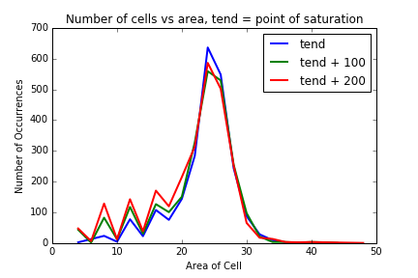
Graphs for square and triangle (both plates of same area 40000)
Square
Triangle

Slide 13
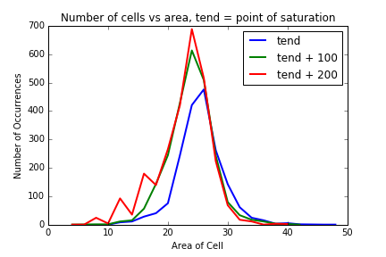
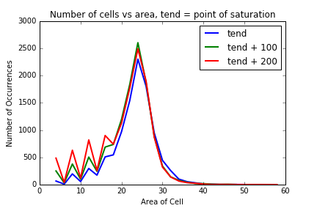
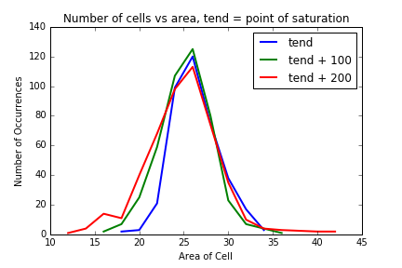
Graphs for plates of radius r, 2r and r/2
Circle ( Radius R/2, Area – 10000)
Circle ( Radius R, Area – 40000)
Circle ( Radius 2R, Area – 160000)

